Slide 1
Cleanse or Detox
Which one (if any) is right for you?

Slide 2
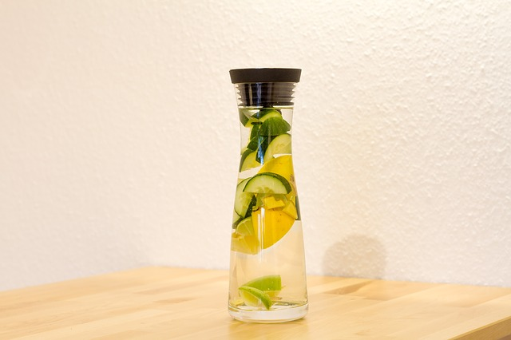
What is a Cleanse or detox?
A Cleanse or a Detox is generally a process that people do in order to “thoroughly clean” their bodies, as if to have a blank slate to begin working with or to start anew.

Slide 3
Who thought this Idea up?
Detoxification as Part of Natural Medicine
Though the first-ever instance of detoxing hasn’t been pinpointed in history, many historians attribute detoxification diets to Ayurveda. Ayurveda, meaning “The Science of Life,” is the practice of natural medicine that originated in India at around 3500 BC. One of the disciplines in Ayurveda is pancha karma, which includes progressively eliminating certain foods from the diet, taking spiritual walks, and cleaning out the colon and the nasal passage. The goal of pancha karma is to prolong life and prevent disease, and to spur spiritual and emotional growth.
Detoxification Through Colonic Irrigation
The use of colon hydrotherapy was first recorded in 1500 BC by the Egyptians. It’s also been mentioned in a document titled “The Essene Gospel of Peace” written in the biblical times approximately 3,500 years ago. Here’s an excerpt: “…suffer the end of the stalk of the trailing gourd to enter your hinder parts, that the water may flow through all your bowels. . .Then let the water run out from your body, that it may carry away from within it all the unclean and evil-smelling things.” The idea is the same today but not quite the equipment!
-http://blog.thedetoxmarket.com/glow-1-1/

Slide 4
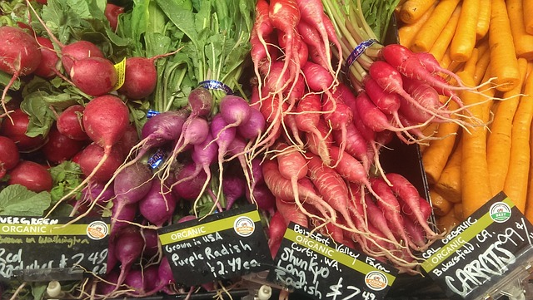
What is it good for?
Detoxes and Cleanses can be an awesome platform, from which to begin a lifestyle change.
However, when done incorrectly (too much too fast), can cause discomfort and an defensive autoimmune response.
This can shock the body and psyche in different ways, both good and bad.
If done poorly can be damaging to the body as much as Yo-yo dieting.

Slide 5
Important: Get very Clear about Why you want to Detox/Cleanse
What do you want to achieve?
Anything too intense is going to cause massive stress on your body.
In my opinion mild detoxes with the long term goal of transitioning into a whole foods, minimally processed, primarily plant based lifestyle is the only reason to do a cleanse/detox.
Your body naturally detoxes as it adapts to a healthier lifestyle.

Slide 6
Who is it good for?
Mild Cleanses/Detox are great for anyone who is fairly healthy and looking to create a lasting lifestyle change.
They are great for people who are willing to look at a healthier lifestyle as one of abundance (all that you are gaining) as opposed to (gerbil food) and all that you are missing out on. So much more is available than most people are aware of.
People who are willing to begin taking responsibility for everything that they put in their body as fuel for healthy living.

Slide 7
What Kinds are available?
There are thousands of cleanses and detoxes available, from very extreme (a 30 day water fast) to very mild (cutting back on potato chips).
They can often be vague and rarely are labeled as EXTREME or MILD.
Here are a few examples:
Raw Foods Juices Smoothies
Water Niacin Fasting
Fruit Feast Colonics Liver Cleanse
Cranberry Flush Sugar Detox Whole 30
Master Cleanse Skin Brushing Fermented foods
Lemon and Water

Slide 8
Which One is Right for Me?
Think about where you are struggling the most with your health.
If your answer is weight…know that all excess body fat is a sign of excess inflammatory foods and emotional eating. Begin by incorporating more alkaline foods in your life.
My suggestion is to always start with something mild that you are willing to incorporate on a regular basis following the cleanse. Think about what you can add in rather than take out. Eventually, cravings for the unhealthier foods will lessen by virtue of “crowding out” with so much goodness.

Slide 9
How long will it last?
Detoxes can be very short→ several hours (colonics)→ to very lengthy (months of only juicing). Generally speaking, anything extreme that is done for too long will generate an auto immune response.
The goal is to create gradual changes that you would be willing to incorporate on a regular basis.
So, you might choose to do a 3-5 day smoothie cleanse followed by incorporating 1-2 smoothies into your daily food intake.
“Add to”= “Abundance”= “Sustainable”

Slide 10
What can I expect to feel?
Ideally, you should feel energized and lighter after a few days.
You might feel tired, a slight headache, with mild skin issues as toxins begin to leave your body.
You can assist this process by increasing your daily water (or water with lemon) intake between meals and dry brushing your skin.

Slide 12
Can it ever be harmful?
Definitively, YES.
You will notice I use the word “mild” repeatedly. Our bodies never do well with extreme, and injuries ensue.
When anything is done with an extreme or deprivation mentality (i.e. no food or nutrients plus intense exercise) can land you in the hospital…usually followed by a binging episode from the emotional trauma and negative self-talk.

Slide 13
How will I know the difference between a detox reaction and something serious?
Anything more than mild discomfort means that too many toxins have been released at once and your body, in its un-ending desire for homeostasis, is not able to cope.
Those toxins can re-enter the system and be overwhelming if they are not removed with significant hydration.
Extended reactions (more than 3 days) usually is a sign that the detox is too extreme for your body to handle and you likely should scale it back somewhat.

Slide 14
How will I feel after it is over?
Again, you should feel lighter, energetic with an ease of movement and being.
You will likely feel that you do not want to put anything in your body that would be unhealthy.
Generally, people feel determined and optimistic and that it has given them direction.

Slide 15
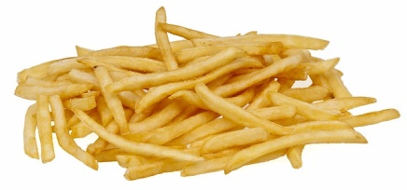
Detox to Retox?
If you are craving unhealthy foods (i.e. “I just want to finish this and reward my self with something really tasty”) then you have probably not adopted the abundance mentality of really tasty healthy foods.
Food should NEVER be used as a reward.
Food is maintenance for your vehicle.
If you wanted your vehicle to consistently run better, would you give it only water…
or would you choose the premium fuel to get the best performance.

Slide 16
Cleanse/Detox as a Gateway to a healthier Lifestyle
All cleanses/detoxes, in isolation are fairly useless and can even be harmful.
They may enable you to experience temporary euphoria from:
Stepping up to a challenge
Cleaning out your body
Trying new foods
Pushing your body to its limits
Beware that your cleanse is something that you can incorporate…otherwise it is just another yo-yo diet that your body will create a defensive response to, often causing more weight gain in the long run.

Slide 17
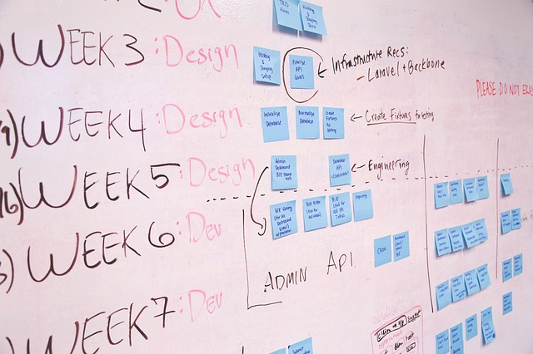
Create A Plan-Things to Consider
What is your cleanse/detox goal? (AKA the reason you are considering this)
Which cleanse/detox resonates with you?
How uncomfortable are you with doing things outside your routine?
How long would you like for your cleanse/detox to last?
How much discomfort are you willing to endure to meet your goal?
Is your choice realistic with your lifestyle?
Where can you slow down to allow your body to heal through this process?

Slide 18
What is my Next Step?
Decide on what kind of cleanse/detox you are interested in trying.
Get clear on what you are wanting to achieve.
Create a plan for success.
Create space to slow down and understand the lessons that may come up through this process (emotional processing, weakness, discomfort)
Create a follow-up plan to incorporate part of the cleanse into your everyday life.

Slide 19
Here’s what you will need:
Decide how much time and money you are willing to invest in this process (think maximum quality over quantity).
Create a plan (put it on the calendar)
Cut back on some of your daily activities, to allow your body to rest, process, and heal.
Purchase the materials/ingredients that you will need.
Schedule prep time (if this is an issue, I can help you).
Create a support team that you can depend on not to let you get sidetracked with things that are not beneficial.

Slide 20
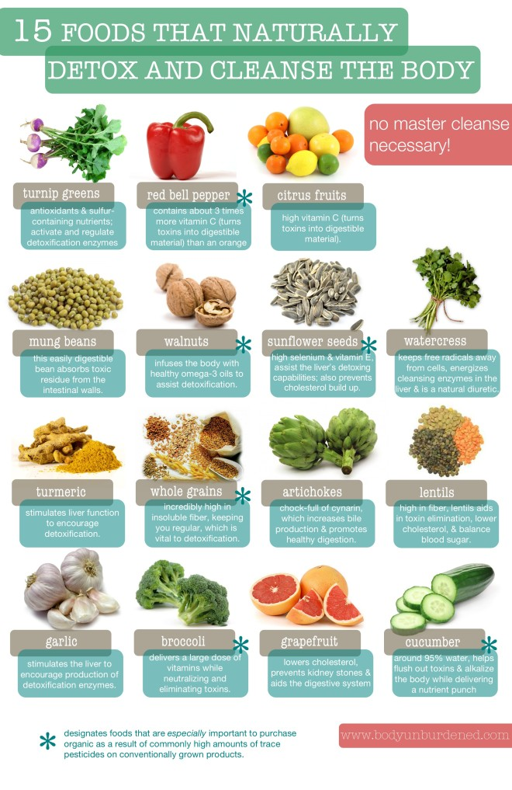
Foods to Support Detox
Here is a brief list:
Shoot for whole foods
Minimally processed
Organic
Locally Grown

Slide 21
Herbs & Spices to Support Detox
1. Cayenne Pepper
Typically used as anti-inflammatory, this spice has many wonderful uses to keep the body healthy. Cayenne Pepper helps soothe sore throats, headaches and can be used as a digestive aid.
How to use: Add a few sprinkles of cayenne pepper to steamed cabbage and carrots or to stews. If you’re experiencing a really bad cold add a little cayenne pepper to hot water and sip slowly.
2. Fennel Seed
This spice is high in fiber, rich in minerals and vitamin B. Fennel seeds are also excellent for helping eliminate waste and cleanse the body.
Not only does it help to control the appetite, fennel seeds like cayenne pepper, has multiple uses including RELIVING SINUS problems, cramps and BLOATING.
How to use: Sprinkle seeds over salads or use over baked vegetables like organic squash and zucchini.
3. Ginger
A favorite anti-inflammatory, helps with blood circulation and preventing clots. One of its primary uses is soothing gas and BLOATING in the GASTROINTESTINAL system.
How to use: Add fresh ginger to GREEN TEA, lemon and organic honey. You can also add a little kick to your smoothies by adding a little ginger.
4. Parsley
Parsley is not just a beautiful garnish, it’s a top choice for kidney and LIVER DETOXIFICATION. This herb is useful for flushing out excess fluid in the kidneys. Packed with Vitamin A, B, C and K, parsley works well as an ANTIOXIDANT.
How to use: You can add parsley to salads or to green smoothies. I also boil parsley in purified water. Drain the water and drink as a tea.
5. Turmeric
Great for LIVER DETOXIFICATION. This anti-inflammatory increases the PRODUCTION of bile in the liver. Warning: Be careful to not overdo it. Like the old saying goes too much of a good thing can be bad for you.
How to use: Add turmeric to your morning smoothies. Simply add a ½ teaspoon of turmeric, ½ teaspoon of organic honey to coconut milk, bananas and pineapple.

Slide 22
Herbs & Spices to Support Detox continued
6 Rosemary
Known for its healing properties, rosemary contains essential oils as cineol, camphene an bornyl acetate. This herb is used topically in skin PRODUCTS as an antiseptic and in food as an anti-inflammatory.
How to use: Rosemary is a great addition to organic chicken, tea and vegetables
7. Cumin
Cumin is an herb that contains potassium and protein. It’s a favorite for helping to LOSE WEIGHT. Cumin is also used as a digestive aid to relieve gas and BLOATING.
How to use: Add this herb to your favorite soups and stews.
8. Curry
Curry is best known for its anti-inflammatory properties. Curry contains curcumin and is used to treat liver conditions and digestive disorders. Curry helps produce glutathione which aids in protecting the liver.
How to use: Use curry in organic chicken and vegetables.
9. Cinnamon
Cinnamon is beneficial to the help in multiple ways. First reports by the U.S. National Library of Medicineindicate Cassia Cinnamon is used to treat gas, diarrhea, nausea, vomiting and muscle spasms, the common cold and ERECTILE DYSFUNCTION.
Cinnamon is also thought to SUPPORT those with DIABETES by lowering blood sugar levels in those with Type 1 and TYPE 2 DIABETES, however research DATA does not support this claim.
How to use: Skip the baked goods containing refined sugar, as this defeats the purpose of DETOXING. Use this spice in teas instead or on baked sweet potatoes.
10. Garlic
Garlic is full of vitamins and minerals like potassium, iron, calcium, magnesium, allicin and selenium that helps your body flush out toxins. Allicin and selenium helps clean the liver and supports the immune system. It also helps reduce CHOLESTEROL and aids in reducing blood pressure.
How to use: Garlic can be used in many meals including soups, stews, green beans and collard greens.
-http://bodydetoxmastery.com/10-top-herbs-and-spices-to-detox-your-body/

Slide 23
How can I best Support you through this?
I can coach you through this process.
We can create a plan that is right for you and your lifestyle.
I can be the one to help you “Tone-down” any plans that are likely to cause your body an autoimmune response.
I can help you to create a long-term protocol for incorporating healthy abundance into your lifestyle.
I can teach you how to prepare the ingredients for your cleanse so that they will be tastier, without adding unhealthy ingredients.
I can also do the prep work for you, if necessary.

